Slide 1
Who’s Not Coming In?
Unlocking Absenteeism Patterns with Logistic Regression
Yuying Li
July 26, 2025

Slide 2


Absenteeism follows patterns!

Slide 3
Agenda Overview
01
02
03
04
Background
Data & Modeling
Model Evaluation
Top Features
05
06
07
Odds Ratios
Key Findings
Practical Applications

Slide 4

Background
Question
Can we predict which employees will have high absenteeism using characteristics like demographics, work conditions, and lifestyle factors?
Method
Logistic regression
Goal
Understand what factors predict high absenteeism
Inspire organizations to make meaning action

Slide 5
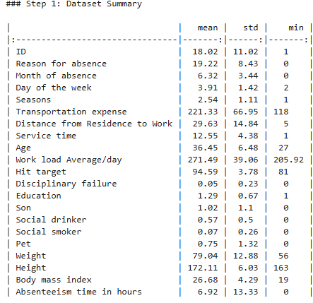
Data & Modeling Approach
Dataset: 740 observations, 21 features (demographics, job info, lifestyle)
Dropped multicollinear features (weight, height)
Used logistic regression (binary classification)
Binary target: High absenteeism (> median hours)
5 seeds generated from Student ID: Best model used seed 8803

Slide 6

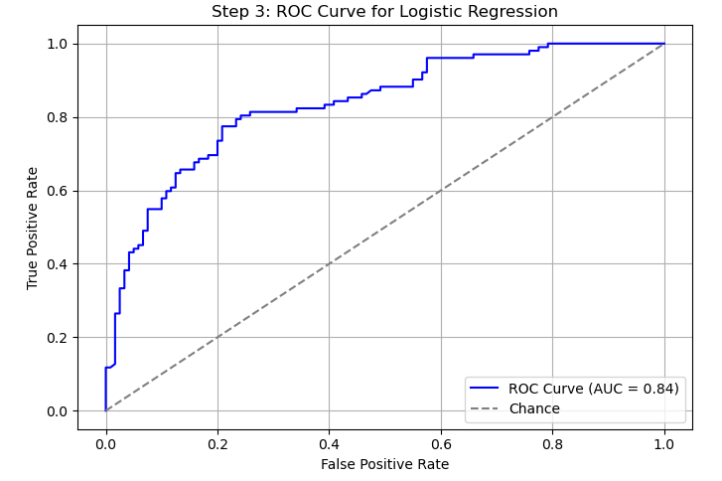
Model Evaluation
Accuracy: 78.4%
Precision (class 1): 75.9%
Recall (class 1): 77.5%
F1 Score (class 1): 77.0%
ROC AUC: 0.84 — strong discrimination ability

Slide 7
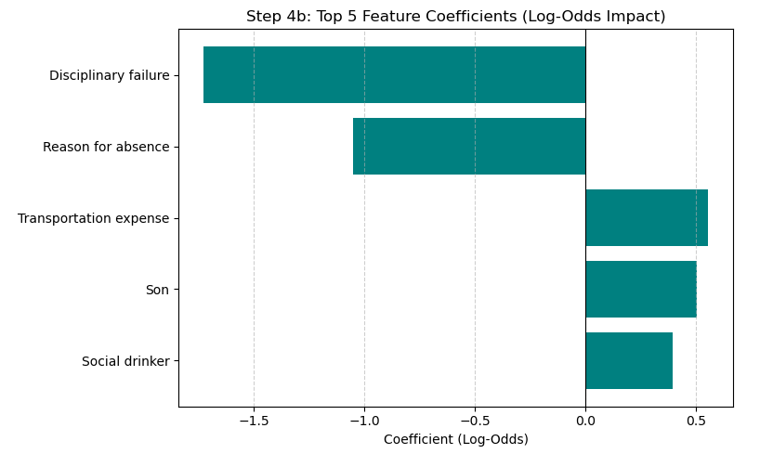
Top Feature Coefficients

Slide 8
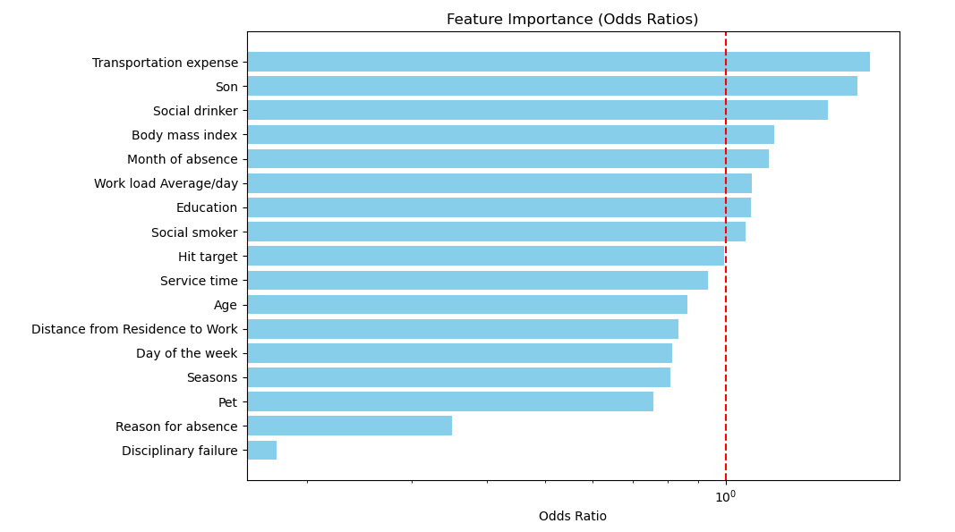
Odds Ratios

Slide 9
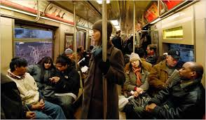


Key Findings
High transportation cost, having children, and social drinking significantly increase the odds of high absenteeism.
Disciplinary failures, surprisingly, are linked to lower absenteeism — possibly due to closer monitoring.
Absenteeism peaks in July, April, and March, suggesting a seasonal trend.
The model achieved 78% accuracy and a strong ROC AUC of 0.84, indicating reliable prediction.
Top predictive features are interpretable and actionable — ideal for HR use.

Slide 10

Practical Applications
Early Intervention: Flag high-risk employees for proactive HR support.
Flexible Work Options: Help reduce absence for those with long commutes or children.
Commuting Support: Offer transit subsidies or shuttle programs to ease transportation burden.
Seasonal Planning: Adjust staffing and project timelines for high-absence months (e.g., July, April).
Policy Reinforcement: Maintain consistent disciplinary policies to support accountability.
Wellness Programs: Target lifestyle-related factors like alcohol use with tailored health initiatives.

Slide 11
THANK YOU
https://github.com/yuyingli58/ANLY510.git

